Slide 1
What’s wrong with Object Oriented Programming
a tale about weird habits of software developers

Slide 2
Habit noun
/ˈhæbɪt/
i
a thing that you do often and almost without thinking, especially something that is hard to stop doing

Slide 3
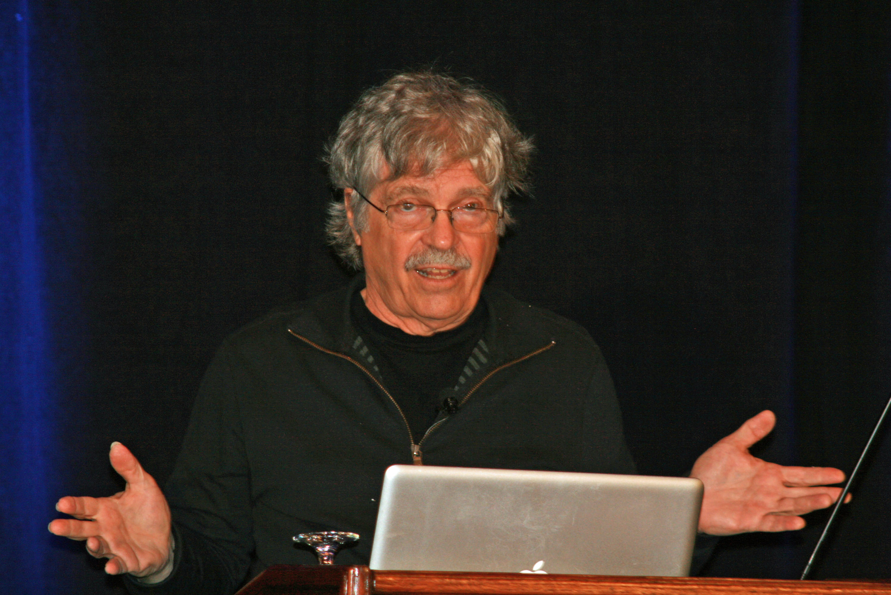
Alan Kay
Father of Object Oriented Programming
Concived Laptop
Contributed to the Client-Server Model
Father of User Interface
Father of Smalltalk
Contributed to the definition of Ethernet

Slide 4
Alan Kay
Father of Object Oriented Programming
“
I made up the term object-oriented, and
I can tell you I didn't have C++ in mind
“

Slide 5
Alan Kay
Father of Object Oriented Programming
“
Java is the most distressing thing to happen to computing since MS-DOS
“

Slide 6
Object
O
An object is a data structure that is made up of behavior and data
Inheritance
I
It’s a mechanism for code reuse to allow independent extension of the original code. It give rise to hierarchies
Method
M
Methods provide the interface that other classes use to access and modify the data of an object

Slide 7


the kingdom of
nouns
take your requirements and circle all nouns, those are your classes. Then underline all the adjectives, those are your properties. Then highlight all your verbs, those are your methods.

Slide 8

Bob, the bald guy
Bob, a bald and nearsighted guy, smokes a cigarette
nouns
verbs
adjectives

Slide 9
Bob, the bald guy
Bob, a bald and nearsighted guy, smokes a cigarette
class Person {
public method <set/get> hairStyle(…)
public method <set/get> bodyLook(…)
public method smoke() {
# smoke the cigarette
}
}
nouns
verbs
adjectives

Slide 10
Bob, the bald guy
Bob, a bald and nearsighted guy, smokes a cigarette
01
retrieve
a cigarette packet
02
grab
the packet
03
take
one cigarette
04
find
a lighter
05
light up
the cigarette
06
smoke

Slide 11
Bob, the bald guy
Bob, a bald and nearsighted guy, smokes a cigarette
class Person {
public method <set/get> hairStyle(…)
public method <set/get> bodyLook(…)
public method smoke() {
# retrieve
# grab
# take
# find
# light-up
# smoke
}
}

Slide 12

Bob, the bald guy
Bob, a bald and nearsighted guy, smokes a cigarette
class Person {
public method <set/get> hairStyle(…)
public method <set/get> bodyLook(…)
public method smoke() {
# call the method sequence
}
private method retrieve() {}
private method grab() {}
private method take() {}
private method find() {}
private method lightUp() {}
private method smoke() {}
}

Slide 13
“
give the people the opportunity of choice and it will be confused with the opportunity to be mistaken
i
“

Slide 14
Bob, the bald guy
obj-1
The pitfall of public and private accessors
class Person {
public variable hairStyle;
public variable bodyLook;
public method <set/get> hairStyle(…)
public method <set/get> bodyLook(…)
public method smoke() {
# call the method sequence
}
private method retrieve() {}
private method grab() {}
private method take() {}
private method find() {}
private method lightUp() {}
private method smoke() {}
}
Object Data/Variables should be private by design
obj-2
Object Behaviour/Methods should be public by design
obj-3

Slide 15
Bob, the bald guy
The pitfall of nouns
Bob, a bald and nearsighted guy, smokes a cigarette
class Person {
method smoke(injected cigaretteWierdClassName) {
// smoke!
}
}
class CigaretteDispatcher{}
class LighterLightningStrategy{}
class CigarettePackageGrabber {}
class LighterFinder {}
class SmokingSessionProvider {}
class CigaretteChooser {}
class CigarettePacketProvider {}
class LighterFinder {}
class CigarettePacketOpener {}
class CigaretteBrandChecker {}
class CigaretteChooser {}
class LighterGasRecharger {}

Slide 16
Bob, the bald guy
The pitfall of nouns
Bob, a bald and nearsighted guy, smokes a cigarette
class Person {
method smoke(injected cigaretteWierdClassName) {
// smoke!
}
}
class CigaretteDispatcher{}
class LighterLightningStrategy{}
class CigarettePackageGrabber {}
class LighterFinder {}
class SmokingSessionProvider {}
class CigaretteChooser {}
class CigarettePacketProvider {}
class LighterFinder {}
class CigarettePacketOpener {}
class CigaretteBrandChecker {}
class CigaretteChooser {}
class LighterGasRecharger {}

Slide 17
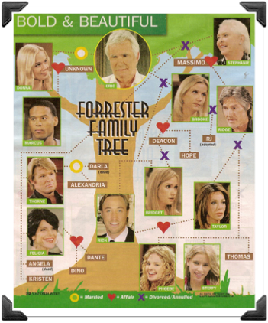
Bob, the bald guy
The pitfall of inheritance
class Person {}
class Gender {}
class Cigarette {}
class Female {}
class Male {}
class BigCigarette {}
class SlimCigarette {}
class Cigar {}
class Packet {}
class CigarettePacket {}
class <brand1> {}
class <brand2> {}
class <brand3> {}

Slide 18
The Square-Rectangle Problem
The pitfall of polymorphism
public class Rectangle {
public method setWidth (double size) { … }
public method getWidth () { … }
public method setHeight (double size) { … }
public method getHeight () { … }
public method getPerimeter() { … }
public method getArea() { … }
}
public class Square extends Rectangle {
public method setSide (double size) {
setWidth(size);
setHeight(size);
}
}
i

Slide 19
How can a so weak paradigm be tought by the same person who invented laptops, UI and so forth?
i

Slide 20
Date: Wed, 23 Jul 2003 09:33:31 -0800
To: Stefan Ram [removed for privacy]
From: Alan Kay [removed for privacy]
Subject: Re: Clarification of "object-oriented"
[some header lines removed for privacy]
Content-Type: text/plain; charset="us-ascii" ; format="flowed"
Content-Length: 4965
Lines: 117
At 6:27 PM +0200 7/17/03, Stefan Ram wrote:
> Dear Dr. Kay,
>
> I would like to have some authoritative word on the term
> "object-oriented programming" for my tutorial page on the
> subject. The only two sources I consider to be "authoritative"
> are the International Standards Organization, which defines
> "object-oriented" in "ISO/IEC 2382-15", and you, because,
> as they say, you have coined that term.

Slide 21
[…]
- I thought of objects being like biological cells and/or individual
computers on a network, only able to communicate with messages (so
messaging came at the very beginning -- it took a while to see how to
do messaging in a programming language efficiently enough to be
useful).
[…]
- I didn't like the way Simula I or Simula 67 did inheritance
(though I thought Nygaard and Dahl were just tremendous thinkers and
designers). So I decided to leave out inheritance as a built-in
feature until I understood it better.
[…]
The original Smalltalk at Xerox PARC came out of the above. The
subsequent Smalltalk's are complained about in the end of the History
chapter: they backslid towards Simula and did not replace the
extension mechanisms with safer ones that were anywhere near as
useful.

Slide 22
OOP to me means only messaging, local retention and protection and
hiding of state-process, and extreme late-binding of all things. It
can be done in Smalltalk and in LISP. There are possibly other
systems in which this is possible, but I'm not aware of them.
Cheers,
Alan

Slide 23
Thank you
sassoroberto@gmail.com
Roberto Sasso
robertosasso84
roberto.sasso

